Slide 1
HACKSPECTRA HACKATHON 2026
Problem Statement Title- Smart Parking Management System
Theme- Smart City
PS Category- Software
Team ID- H48
Team Name - Team Rapidash

Slide 2


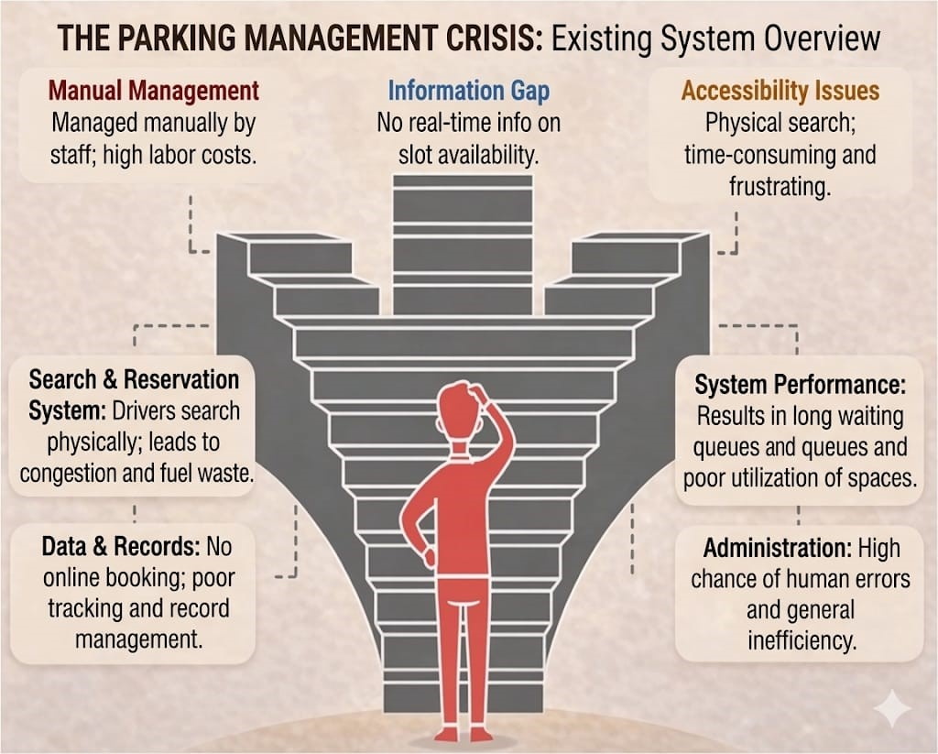
Team Rapidash
Existing Solution
Proposed Solution ✅
Provides a smart and automated parking system for easy slot finding and reservation.
Displays real-time availability of parking spaces to improve user experience.
Enables users to book parking slots in advance through a web or mobile application.
Allows users to enter and manage vehicle details for better tracking and management.
Provides an easy option to view, manage, and cancel bookings when required.
Includes an admin panel to manage users, parking slots, bookings, add slots, and pricing efficiently.
Supports online payment integration and refund options for user convenience.
Designed to be scalable and suitable for malls, offices, airports, and smart cities.

Slide 3


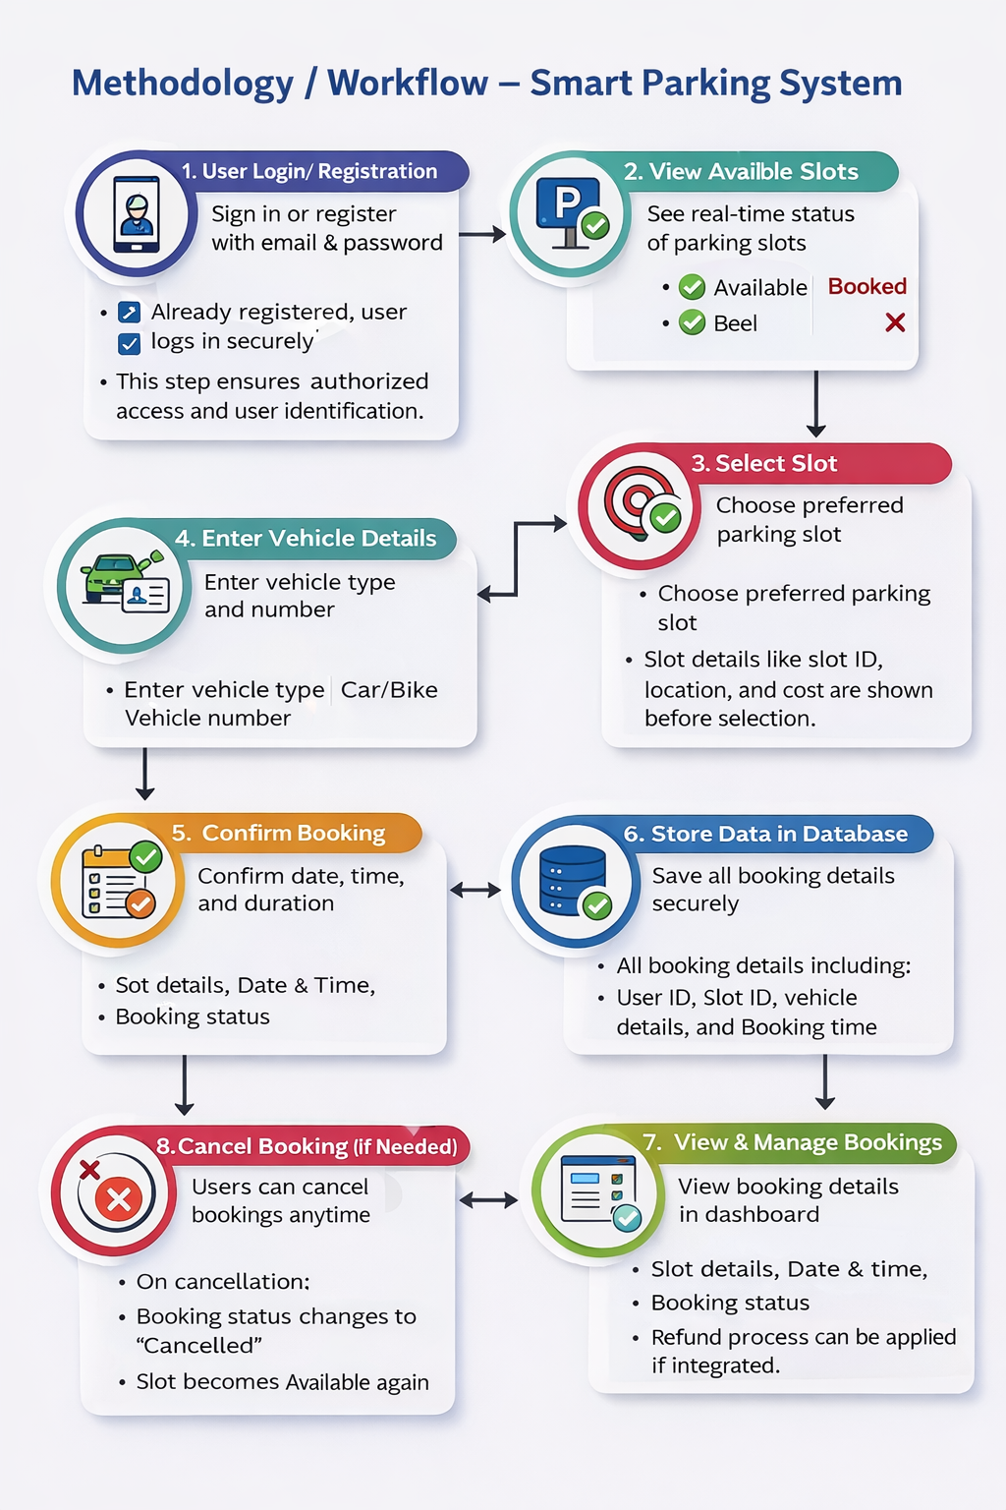
TECHNICAL APPROACH
Team Rapidash
Methodology
Technology Stack
Frontend :
HTML (Structure of pages)
CSS / Tailwind CSS (Design & UI)
JavaScript (User interaction & logic)
Backend :
Python (Core programming language)
Flask (Web framework for API & server)
Database
MySQL (Store users, slots, bookings data)
API Communication
REST API (Connect frontend & backend)
JSON (Data format for sending/receiving data)

Slide 4


FEASIBILITY AND VIABILITY
Team Rapidash
Feasibility
Viability
The system has high demand in crowded urban and metropolitan areas.
It generates revenue through parking bookings and service charges.
It helps users save time and fuel by reducing unnecessary searching.
The system is scalable and can be expanded to multiple locations and cities.
It supports long-term sustainability and efficient resource utilization.
It improves overall parking efficiency and management.
The system is technically feasible using modern web and software technologies.
It requires low development and implementation cost compared to traditional systems.
The system is easy to operate and designed to be user-friendly.
It can be developed and deployed within a limited time frame.
There are no major legal or regulatory restrictions for implementation.
The solution is suitable for integration into smart city environments.

Slide 5


IMPACT AND BENEFITS
Team Rapidash
Impact
Benefits
The system reduces traffic congestion by optimizing parking search.
It saves fuel and reduces overall travel cost.
It decreases air pollution and carbon emissions.
It saves time by providing quick access to parking slots.
It improves user convenience through easy booking options.
It supports smart city development and digital infrastructure.
It ensures efficient utilization of available parking space.
The system reduces traffic congestion by minimizing unnecessary searching.
It helps users find parking slots quickly and easily.
It saves fuel and reduces overall cost.
It improves time efficiency for users.
It enhances user convenience through digital access.
It supports smart city development and automation.
It enables efficient digital parking management.
It improves overall parking space utilization.

Slide 6


CONCLUSION
Team Rapidash
FUTURE SCOPE
The system can use AI for predicting parking availability.
It can integrate IoT sensors for real-time slot detection.
It can be connected with GPS and navigation systems.
It can support EV charging-enabled parking slots.
It can include Automatic Number Plate Recognition (ANPR).
It can enable smart automation and contactless entry systems.
The Smart Parking Management System provides an efficient and automated solution to overcome the challenges of traditional parking systems.
It helps in reducing traffic congestion, saving time, and minimizing fuel consumption, making daily commuting easier for users.
The project contributes to environmental sustainability by reducing unnecessary vehicle movement and pollution.
It also supports the concept of smart cities by introducing digital and intelligent infrastructure for urban management.

Slide 7
THANK YOU

